Slide 1
A very short overview on the Off-Axis Holography System

Slide 2
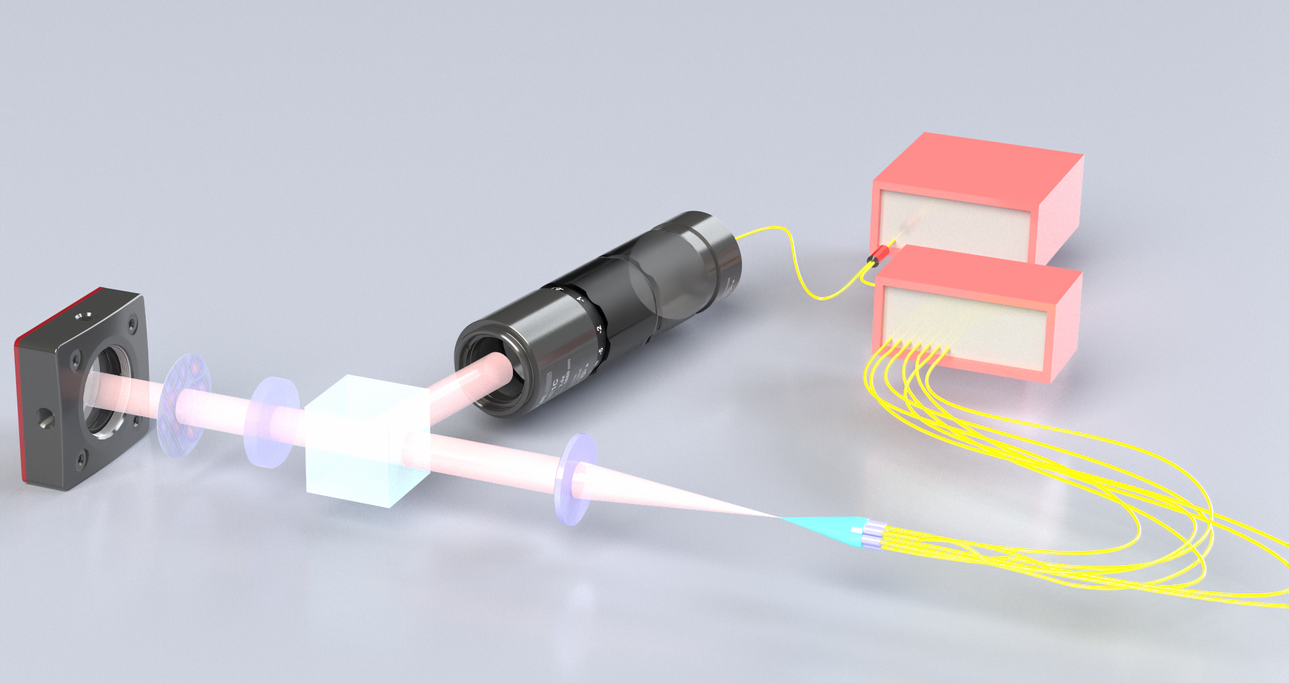
Make sure you have code (ask me) that connects to these 4 things:
Tunable Laser Source for Wavelength Selectivity
Motorized Polarization Paddle
Fiber Switch Control For Lantern Legs
Camera Frame Grabber
Physical Requirements
Make sure the reference beam is polarized correctly using the manual paddles
Use Red Light checker through one leg for coarse alignment to camera
Bonus: Use a power meter if you want to measure transmission, but you’d have to calibrate insertion loss through all of the switch ports and hope the connectors are good
Laser Source
Beam Expander
10:90 Splitter
Polarization Paddles Go Here
InGaAs Camera
Beam Splitter
Optical Switch
Polarizer
Lens
Photonic Lantern

Slide 3
Workflow for Data Collection:
This may need to be done manually depending on switch
Wait
Wait
Start
Connect All Software
For each leg:
Select Leg
For each 𝜆:
Select Wavelength
Are Fringes Visible?
Change Polarization
nah
nah
nah
yea
Dope
Was that all the legs?
yea
Was that all wave- lengths?
Record Image
yea
Save images something like:
(leg)##-(wavelength)####.npy
Loop can be adjusted, but I would have the slowest moving part on towards the outside of the loop, testing should be done to figure out appropriate wait times

Slide 4
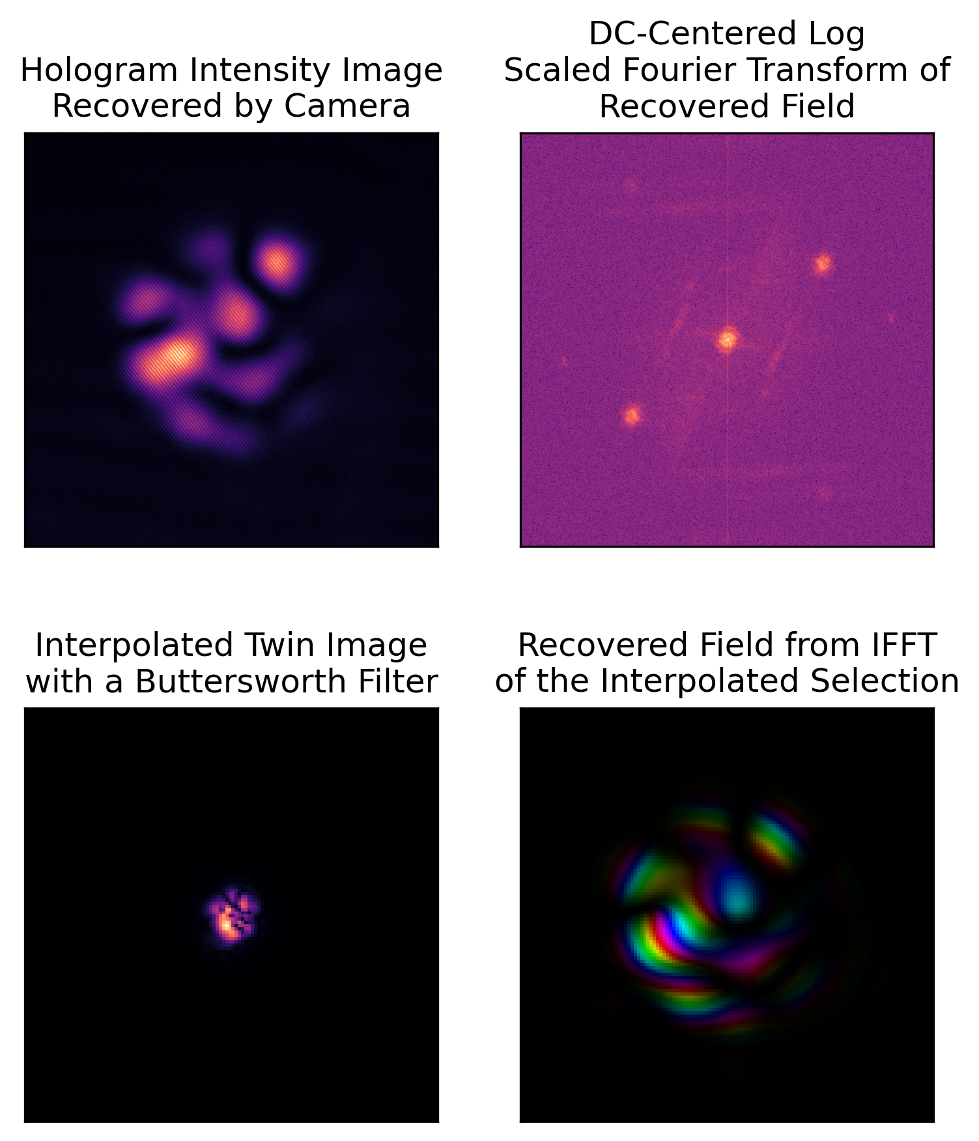
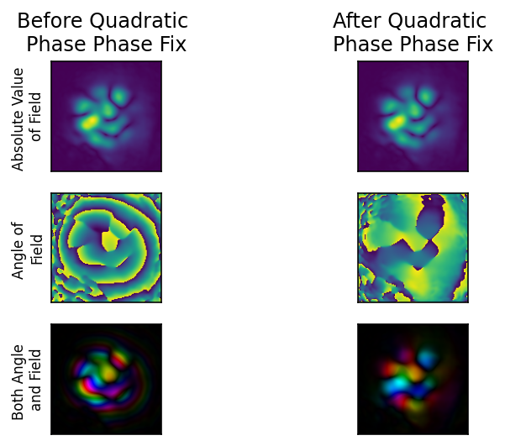
Workflow for Data Processing:
Note: Centroid locations are wavelength dependent
Start
Load Data Set
Find Center of Field
Find Centroids of Twin Images in FFT
Find Ballpark Quadratic Phase Error
Find (or calculate) Ballpark Mode Field Sizes
Dope
Make fun plots
Set LP01 Phase to 0
Save Decomp and Recovered Fields
Save Ideal Parameters
Optimize Parameters [X/Y Offset, Diameter, Phase Factor]
Note: This is a very involved process that can use improvement. I will share example code, but the idea is you compare a field constructed of idealized modes with your data and try for the closest match.

